Slide 1
Dynamic Programming I
weighted interval scheduling
segmented least squares
knapsack problem

Slide 2
Algorithmic paradigms
Greed. Process the input in some order, myopically making irrevocable decisions.
Divide-and-conquer. Break up a problem into independent subproblems; solve each subproblem; combine solutions to subproblems to form solution to original problem.
Dynamic programming. Break up a problem into a series of overlapping subproblems; combine solutions to smaller subproblems to form solution to large subproblem.
fancy name for caching intermediate results
in a table for later reuse

Slide 3
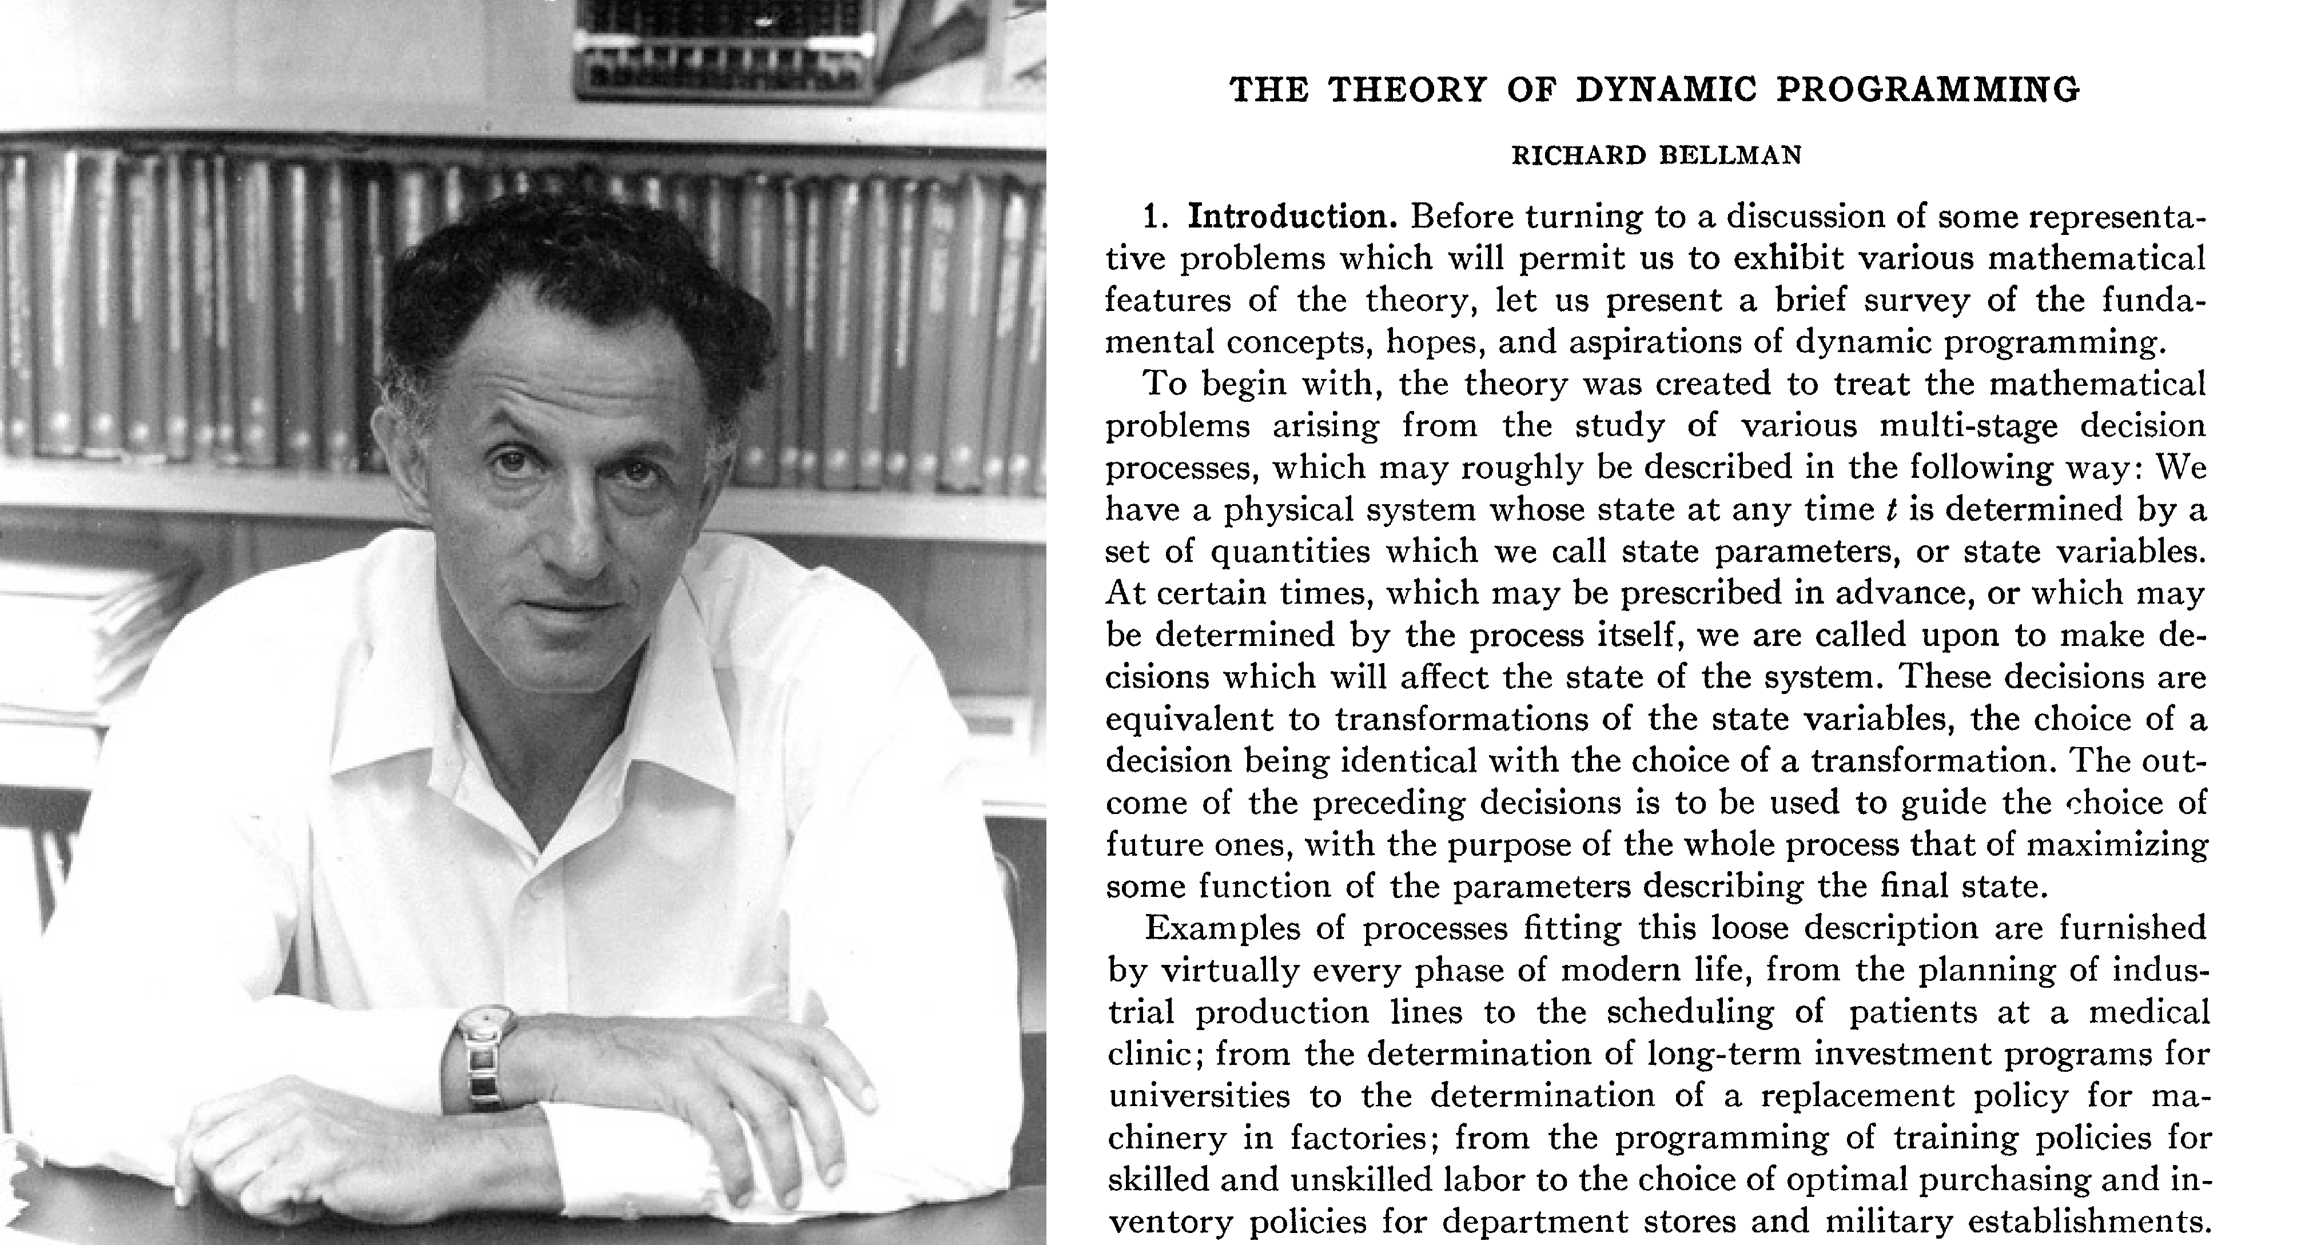
Dynamic programming history
Bellman. Pioneered the systematic study of dynamic programming in 1950s.
Etymology.
・Dynamic programming = planning over time.
・Secretary of Defense had pathological fear of mathematical research.
・Bellman sought a “dynamic” adjective to avoid conflict.

Slide 4
Dynamic programming applications
Application areas.
・Computer science: AI, compilers, systems, graphics, theory, ….
・Operations research.
・Information theory.
・Control theory.
・Bioinformatics.
Some famous dynamic programming algorithms.
・Avidan–Shamir for seam carving.
・Unix diff for comparing two files.
・Viterbi for hidden Markov models.
・De Boor for evaluating spline curves.
・Bellman–Ford–Moore for shortest path.
・Knuth–Plass for word wrapping text in T1X.
・Cocke–Kasami–Younger for parsing context-free grammars.
・Needleman–Wunsch/Smith–Waterman for sequence alignment.

Slide 5
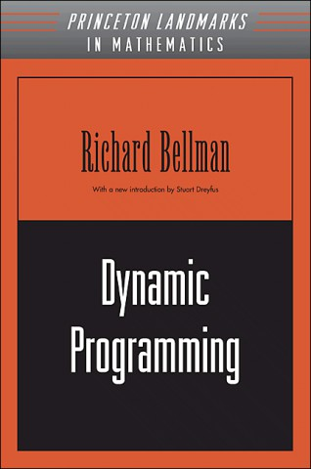
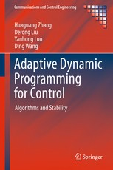
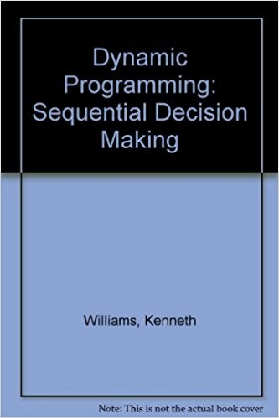
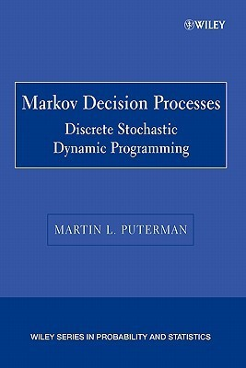


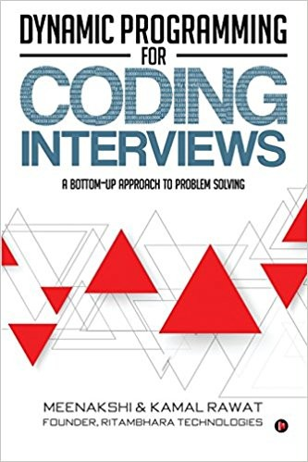
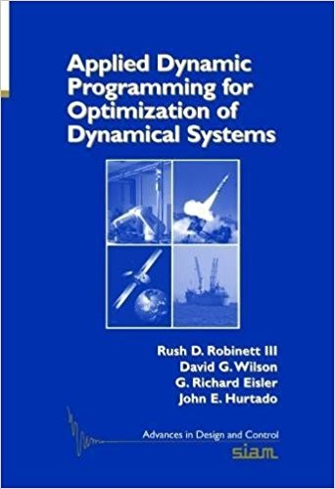
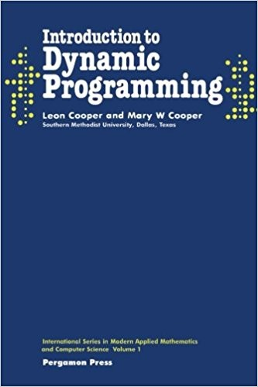

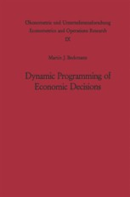

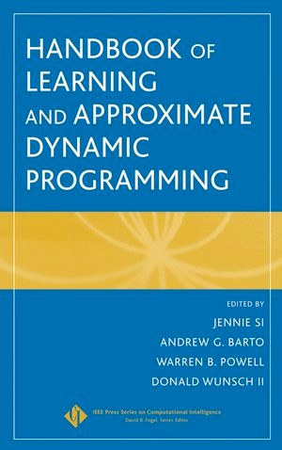
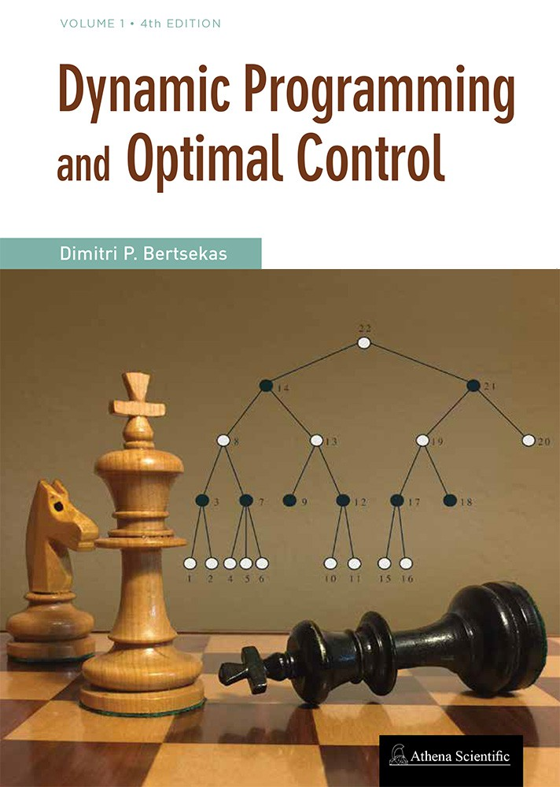
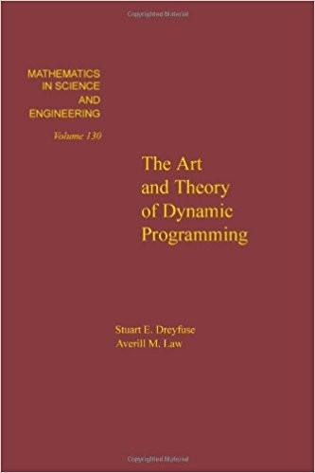
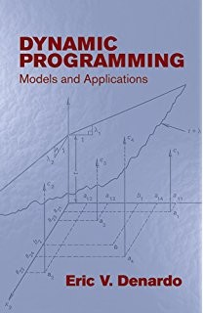
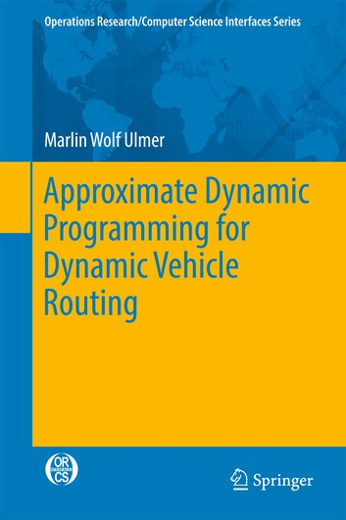



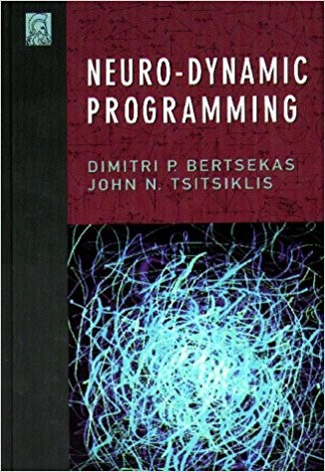
Dynamic programming books

Slide 6
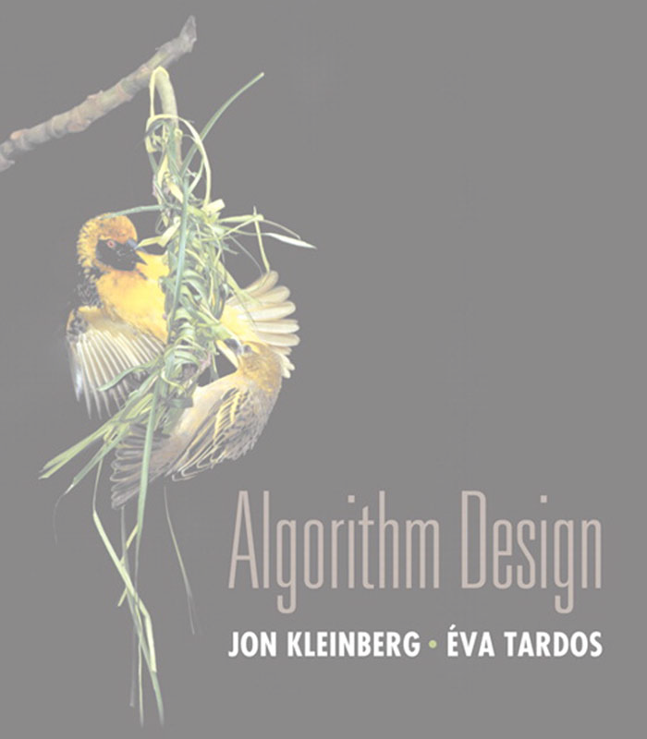

6. Dynamic Programming I
weighted interval scheduling
segmented least squares
knapsack problem
RNA secondary structure
Sections 6.1–6.2

Slide 7
Weighted interval scheduling
・Job j starts at sj, finishes at fj, and has weight wj > 0.
・Two jobs are compatible if they don’t overlap.
・Goal: find max-weight subset of mutually compatible jobs.
sj
wj
fj
a
b
c
d
e
f
g
h
time
0
1
2
3
4
5
6
7
8 9 10 11

Slide 8
Earliest-finish-time first algorithm
Earliest finish-time first.
・Consider jobs in ascending order of finish time.
・Add job to subset if it is compatible with previously chosen jobs.
Recall. Greedy algorithm is correct if all weights are 1.
Observation. Greedy algorithm fails spectacularly for weighted version.
weight = 999
b
weight = 1
weight = 1
a
h
time
0
1
2
3
4
5
6
7
8
9 10
11

Slide 9
Weighted interval scheduling
Convention. Jobs are in ascending order of finish time: f₁ ≤ f₂ ≤ . . . ≤ f_{n} .
Def. p( j ) = largest index i < j such that job i is compatible with j. Ex.
p(8) = 1, p(7) = 3, p(2) = 0.
i is rightmost interval that ends before j begins
1
2
3
4
5
6
7
8
time
0
1
2
3
4
5
6
7
8
9 10
11

Slide 10
Dynamic programming: binary choice
Def. OPT( j ) = max weight of any subset of mutually compatible jobs for subproblem consisting only of jobs 1, 2, ..., j.
Goal.
OPT(n) = max weight of any subset of mutually compatible jobs.
Case 1. OPT( j ) does not select job j.
・Must be an optimal solution to problem consisting of remaining jobs 1, 2, ..., j – 1.
optimal substructure property
Case 2. OPT( j ) selects job j.
(proof via exchange argument)
・Collect profit wj.
・Can’t use incompatible jobs { p( j ) + 1, p( j ) + 2, ..., j – 1 }.
・Must include optimal solution to problem consisting of remaining compatible jobs 1, 2, ..., p( j ).
0
max { OPT (j — 1), w_{j} + OPT (p(j)) }
if j = 0
if j > 0
Bellman equation.
OPT (j) =

Slide 11
Weighted interval scheduling: brute force
BRUTE-FORCE (n, s1, …, sn, f1, …, fn, w1, …, wn)
Sort jobs by finish time and renumber so that f1 ≤
Compute p[1], p[2], …, p[n] via binary search. RETURN COMPUTE-OPT(n).
f2 ≤ … ≤ fn.
COMPUTE-OPT( j ) IF (j = 0)
RETURN 0.
Else
RETURN max {COMPUTE-OPT( j – 1), wj + COMPUTE-OPT( p[ j ]) }.

Slide 12

Dynamic programming: quiz 1
What is running time of COMPUTE-OPT(n) in the worst case?
A. Θ(n log n)
B.
C.
D.
Θ(n²)
T (n) = ,
Θ(1) B7 n = 1
2T (n — 1) + Θ(1) B7 n > 1
Θ(1.618^{n})
Θ(2^{n})
COMPUTE-OPT( j ) IF (j = 0)
RETURN 0.
Else
RETURN max {COMPUTE-OPT( j – 1), wj + COMPUTE-OPT( p[ j ]) }.
12

Slide 13
Weighted interval scheduling: brute force
Observation. Recursive algorithm is spectacularly slow because of overlapping subproblems ⇒ exponential-time algorithm.
Ex. Number of recursive calls for family of “layered” instances grows like Fibonacci sequence.
5
1
 |  | 2
 |  |  |  |  | 3
 |  |  |  |  |  |  | 4
 |  |  |  |  |  |  |  | 5
4
3
3
2
2
1
2
1
1
0
1
0
p(1) = 0, p(j) = j-2
1
0
recursion tree

Slide 14
Weighted interval scheduling: memoization
Top-down dynamic programming (memoization).
・Cache result of subproblem j in M [ j ].
・Use M [ j ] to avoid solving subproblem j more than once.
TOP-DOWN(n, s1, …, sn, f1, …, fn, w1, …, wn)
Sort jobs by finish time and renumber so that f1 ≤ f2 ≤ … ≤ fn. Compute p[1], p[2], …, p[n] via binary search.
M [0 ] ← 0.
global array
Return M-Compute-Opt(n).
M-Compute-Opt( j )
IF (M [ j ] is uninitialized)
M [ j ] ← max { M-COMPUTE-OPT ( j – 1), wj + M-COMPUTE-OPT( p[ j ]) }.
RETURN M [ j ].

Slide 15
Weighted interval scheduling: running time
Claim. Memoized version of algorithm takes O(n log n) time. Pf.
・Sort by finish time:
O(n log n) via mergesort.
・Compute p[ j ] for each j : O(n log n) via binary search.
・M-COMPUTE-OPT( j ): each invocation takes O(1) time and either
-
-
returns an initialized value M [ j ]
initializes M [ j ] and makes two recursive calls
・Progress measure Φ = # initialized entries among M [1.. n ].
-
-
initially Φ = 0; throughout Φ ≤ n.
(2) increases Φ by 1 ⇒ ≤ 2n recursive calls.
・Overall running time of M-COMPUTE-OPT(n) is O(n). ▪

Slide 16



Slide 17
Weighted interval scheduling: finding a solution
Q. DP algorithm computes optimal value. How to find optimal solution?
A. Make a second pass by calling Find-Solution(n).
Find-Solution( j )
IF (j = 0) RETURN
Else if (wj Return
Else
Return
∅.
+ M [ p[ j ]] > M [ j – 1])
{ j } ∪ FIND-SOLUTION(p[ j ]).
Find-Solution( j – 1).
M [ j ] = max { M[j – 1], wj + M[p[ j ]] }.
Analysis. # of recursive calls ≤ n ⇒ O(n).

Slide 18
Weighted interval scheduling: bottom-up dynamic programming
Bottom-up dynamic programming. Unwind recursion.
BOTTOM-UP(n, s1, …, sn, f1, …, fn, w1, …, wn)
Sort jobs by finish time and renumber so that f1 ≤ f2 ≤ … ≤ fn. Compute p[1], p[2], …, p[n].
M [0 ] ← 0. FOR j = 1 TO n
previously computed values
M [ j ] ← max { M [ j – 1], wj + M [ p[ j ]] }.
Running time. The bottom-up version takes O(n log n) time.

Slide 19


Maximum subarray problem
Goal. Given an array x of n integer (positive or negative), find a contiguous subarray whose sum is maximum.
12
5
−1
31
−61
59 | 26 | −53 | 58 | 97
−93
−23
84
−15
6
187
Applications. Computer vision, data mining,
genomic sequence analysis, technical job interviews, ….
19

Slide 20
Maximum subarray problem
Goal. Given an array x of n integer (positive or negative), find a contiguous subarray whose sum is maximum.
i j
12
5
−1
31
59 | 26 | −53 | 58 | 97
−23
84
−15
6
−61 −93
187
Brute-force algorithm.
・For each i and j : computer a[i] + a[i+1] + … + a[j].
・Takes Θ(n³) time.
Apply “cumulative sum” trick.
・Precompute cumulative sums:
S[i] = a[0] + a[1] + … + a[i].
・Now a[i] + a[i+1] + … + a[j] = S[j] − S[i−1].
・Improves running time Θ(n²).
20

Slide 21

Kadane’s algorithm
Def.
OPT( i ) = max sum of any subarray of x whose rightmost index is i.
Goal.
max OPT (i)
i
if i = 1
if i > 1
Bellman equation.
OPT (i) = ^{x1}
max { x_{i}, x_{i} + OPT (i — 1) }
Running time.
O(n).
take only element i
take element i
together with best subarray ending at index i − 1
21

Slide 22
Maximum rectangle problem
Goal. Given an n-by-n matrix A, find a rectangle whose sum is maximum.
,
—2
5 | 0 —5 | —2 | 2 | —3
—3 | —1 3 | 2 | 1 | —1
6 | 3 —5 | —1 | —4 | —2
—1 | 3 —1 | 4 | 1 | 1
—3 | 2 0 | 3 | —3 | —2
1 | —2 1 | 1 | 3 | —1
—4 | 0 1 | 0 | —3 | —1
4
—5
A =
—1
3
,
—2
2
13
Applications. Databases, image processing, maximum likelihood estimation, technical job interviews, …
22

Slide 23
Bentley’s algorithm
Assumption. Suppose you knew the left and right column indices j and j ʹ.
,
j |  | j ʹ
—2 5 0 4 —3 —1 | —5 3 | —2 2 | 2 —3 1 —1
, —7
4
0 − 5 − 2
—5 6 3 —5 —1 —4 —2
A = —1 —1 3 —1 4 1 1
3 —3 2 0 3 —3
—2 1 —2 1 1 3 —1
2 —4 0 1 0 —3 —1
—3
x = 6
—2
5
,
,
0
1
An O(n³) algorithm.
Precompute cumulative row sums S
・For each j < j ʹ :
j
solve maximum subarray problem in this array
・
Σ
ij
= A
ik
.
k =1
–
–
define array x using row-sum differences: xi = Sij' — Sij
run Kadane’s algorithm in array x
Open problem.
O(n^{3−ε}) for any constant ε > 0.
23

Slide 24
6. Dynamic Programming I
weighted interval scheduling
segmented least squares
knapsack problem
RNA secondary structure
Section 6.3

Slide 25
Least squares
Least squares. Foundational problem in statistics.
・Given n points in the plane: (x1, y1), (x2, y2) , …, (xn, yn).
・Find a line y = ax + b that minimizes the sum of the squared error:
n
Σ
i=1
SSE =
(y
i
— ax − b)
2
i
y
x
Solution. Calculus ⇒ min error is achieved when
Σ
Σ Σ
Σ
Σ
n
x y − (
_{Σ}i
x )( y )
y − a
x
i
i i
i
i
i
i
i
i
i
a =
Σ
, b =
n x² − (
x_{i})²
n
i
i
i
25

Slide 26










Segmented least squares
Segmented least squares.
・Points lie roughly on a sequence of several line segments.
・Given n points in the plane: (x1, y1), (x2, y2) , …, (xn, yn) with
x1 < x2 < ... < xn, find a sequence of lines that minimizes f (x).
Q. What is a reasonable choice for f (x) to balance accuracy and parsimony?
goodness of fit
number of lines
y
x

Slide 27
Segmented least squares
Segmented least squares.
・Points lie roughly on a sequence of several line segments.
・Given n points in the plane: (x1, y1), (x2, y2) , …, (xn, yn) with
x1 < x2 < ... < xn, find a sequence of lines that minimizes f (x).
Goal. Minimize f (x) = E + c L for some constant c > 0, where
・E = sum of the sums of the squared errors in each segment.
・L = number of lines.
y
x

Slide 28
Dynamic programming: multiway choice
Notation.
・OPT( j )
・eij
= minimum cost for points p1, p2, …, pj.
= SSE for for points pi, pi+1, …, pj.
To compute OPT( j ):
・Last segment uses points pi, pi+1, …, pj for some i ≤ j.
・Cost = eij + c + OPT(i – 1).
optimal substructure property (proof via exchange argument)
Bellman equation.
,
if j = 0
if j > 0
0
OPT (j) =
min { e_{ij} + c + OPT (i — 1) }
1≤i≤j

Slide 29
Segmented least squares algorithm
SEGMENTED-LEAST-SQUARES(n, p1, …, pn, c)
FOR j = 1 TO n
FOR i = 1 TO j
Compute the SSE eij for the points pi, pi+1, …, pj.
M [ 0] ← 0. FOR j = 1 TO n
previously computed value
M [ j ] ← min 1 ≤ i ≤ j { eij + c + M [ i – 1] }.
Return M [ n].

Slide 30
Segmented least squares analysis
Theorem. [Bellman 1961] DP algorithm solves the segmented least squares problem in O(n³) time and O(n²) space.
Pf.
・Bottleneck = computing SSE eij for each i and j.
_{n} Σ Σ
x_{k}y_{k} − (^{Σ} x_{k})(^{Σ} y_{k})
y_{k} − a_{ij} ^{Σ} x_{k}
aij
=
k
Σ
_{Σ}k
k
, =
k
k
n _{k} x² − (
_{k} x_{k})²
bij
n
k
・O(n) to compute eij. ▪
Remark. Can be improved to O(n²) time.
i
i
i
i
・
Σ
Σ
Σ
Σ
For each i : precompute cumulative sums
x ,
y ,
2
.
k
k
x ,
x_{k}y_{k}
k
k=1 k=1
k=1
k=1
・Using cumulative sums, can compute eij in O(1) time.

Slide 31
6. Dynamic Programming I
weighted interval scheduling
segmented least squares
knapsack problem
RNA secondary structure
Section 6.4

Slide 32


Knapsack problem
Goal. Pack knapsack so as to maximize total value of items taken.
・There are n items: item i provides value vi > 0 and weighs wi > 0.
・Value of a subset of items = sum of values of individual items.
・Knapsack has weight limit of W.
Ex. The subset { 1, 2, 5 } has value $35 (and weight 10). Ex. The subset { 3, 4 } has value $40 (and weight 11).
Assumption. All values and weights are integral.
i | vi | wi
1 | $1 | 1 kg
2 | $6 | 2 kg
3 | $18 | 5 kg
4 | $22 | 6 kg
5 | $28 | 7 kg
$18
5 kg
weights and values can be arbitrary positive integers
$22
6 kg
11 kg
$6
2 kg
$28
7 kg
$1
1 kg
knapsack instance
(weight limit W = 11)
Creative Commons Attribution-Share Alike 2.5
by Dake
32

Slide 33
Dynamic programming: two variables
Def. OPT(i, w) = optimal value of knapsack problem with items 1, …, i, subject to weight limit w.
Goal. OPT(n, W).
possibly because wi > w
Case 1. OPT(i, w) does not select item i.
・OPT(i, w) selects best of { 1, 2, …, i – 1 } subject to weight limit w.
Case 2. OPT(i, w) selects item i.
optimal substructure property (proof via exchange argument)
・Collect value vi.
・New weight limit = w – wi.
・OPT(i, w) selects best of { 1, 2, …, i – 1 } subject to new weight limit.
Bellman equation.
,
if i = 0
if w_{i} > w
otherwise
,
0
,
OPT (i, w)
=
OPT (i — 1, w)
, max { OPT (i — 1, w),
v_{i} + OPT (i — 1,w — w_{i}) }

Slide 34
Knapsack problem: bottom-up dynamic programming
KNAPSACK(n, W, w1, …, wn, v1, …, vn )
FOR w = 0 TO W M [ 0, w ] ← 0.
For i = 1 to n
For w = 0 to W
previously computed values
IF (wi > w) M [ i, w ] ← M [ i – 1, w ].
ELSE M [ i, w ] ← max { M [ i – 1, w ], vi + M [ i – 1, w – wi] }.
RETURN M [ n, W].
,
if i = 0
if w_{i} > w
otherwise
,
0
,
OPT (i, w)
=
OPT (i — 1, w)
, max { OPT (i — 1, w),
v_{i} + OPT (i — 1,w — w_{i}) }

Slide 35
Knapsack problem: bottom-up dynamic programming demo
i | vi | wi
1 | $1 | 1 kg
2 | $6 | 2 kg
3 | $18 | 5 kg
4 | $22 | 6 kg
5 | $28 | 7 kg
,
,
0
if i = 0
if w_{i} > w
otherwise
,
OPT (i, w) =
OPT (i — 1, w)
, max {OPT (i — 1, w), v_{i} + OPT (i — 1,w — w_{i}}
weight limit w
 |  | 0 | 1 | 2 | 3 | 4 | 5 | 6 | 7 | 8 | 9 | 10 | 11
 | { } | 0 | 0 | 0 | 0 | 0 | 0 | 0 | 0 | 0 | 0 | 0 | 0
 | { 1 } | 0 | 1 | 1 | 1 | 1 | 1 | 1 | 1 | 1 | 1 | 1 | 1
subset | { 1, 2 } | 0 | 1 | 6 | 7 | 7 | 7 | 7 | 7 | 7 | 7 | 7 | 7
of items 1, …, i | { 1, 2, 3 } | 0 | 1 | 6 | 7 | 7 | 18 | 19 | 24 | 25 | 25 | 25 | 25
 | { 1, 2, 3, 4 } | 0 | 1 | 6 | 7 | 7 | 18 | 22 | 24 | 28 | 29 | 29 | 40
 | { 1, 2, 3, 4, 5 } | 0 | 1 | 6 | 7 | 7 | 18 | 22 | 28 | 29 | 34 | 35 | 40
OPT(i, w) = optimal value of knapsack problem with items 1, …, i, subject to weight limit w

Slide 36
Knapsack problem: running time
Theorem. The DP algorithm solves the knapsack problem with n items and maximum weight W in Θ(n W) time and Θ(n W) space.
Pf.
・Takes O(1) time per table entry.
weights are integers between 1 and W
・There are Θ(n W) table entries.
・After computing optimal values, can trace back to find solution:
OPT(i, w) takes item i iff M [i, w] > M [i – 1, w]. ▪
Remarks.
・Algorithm depends critically on assumption that weights are integral.
・Assumption that values are integral was not used.

